Slide 1

MAP
Executive Overview
Kinetium Inc.
Notes:
Structure
A little more method overview
Add “Basic Modeling”: objects + actions → info + behavior models (without any diagrams??)
Add fully-worked, tiny case study as posters
Include notation summaries
Main structure should reflect new method documentation

Slide 2
Outline
What is MAp?
MAp – Formal Architecture Framework
  Goal Modeling
  Viewpoints and Concerns – Black Box, White Box, Technical, …
  Architecture Style
MAp – Process Pragmatics
  Iterative and Incremental
  Roadmap Route: Problem Definition, Current State, Target State, Migration Plan
  Flexible Models and Domains
Summary

Slide 3


What is MAP?
MAP – Model-Driven Approach for clear, business-aligned, architectural solutions
MAP is a systematic approach to plan, architect, develop, and evolve software systems
  Clearly separated viewpoints and models to design or analyze an architecture
1. Business Driven
business goals, terminology, process first
relate disparate views
relate multiple systems, programs, initiatives
2. Traceability
bridge Business and IT
precise shared vocabulary
critical business questions early
5. Reuse Process
reuse business models
… and architectures
… and implementations
develop for reuse
develop with reuse
4. Consistent Architecture
blueprint for consistency
principles, patterns, styles
both business and technical
standards for interoperability
3. Design and Assemble Pluggable Components
federated components, services; not monolithic systems
clear interfaces and responsibilities
reusable and maintainable building blocks
Builds upon best practice and industry standards for architecture: UML, EDOC, RM-ODP, Catalysis, Simple Components, RUP, Problem Frames, Goal Modeling

Slide 4


What Questions Does MAp Ask?
What are the properties of the box visible at its boundary?
functionality: services offered and
required, events handled,
information handled
others: volumes, performance,
location, security, tech platform
Why? What is the bigger goal being achieved outside? How is our box combined with other parts to solve it?
Are there better approaches?
What is the boundary of the “box”
we are describing?
Workers
Policies
Our Box
Resources
What internal “boxes” can be combined to do the job?
Existing or New boxes?
How to partition behavior and information responsibility to meet end-to-end needs?
What are the properties of each internal box?
functionality: services offered and
required, events handled,
information handled
others: volumes, performance,
location, security, tech platform
What consistent principles, patterns, or styles guide our design and are shared across components?
How should we document all these?

Slide 5
Two Aspects of the MAP Framework
Formal Architecture Framework
Goals
Viewpoints
Concerns
Models
Refinement
Architecture Styles
Process Pragmatics
Routes: Roadmap, Construction, …
Different Entry Points
Iterative and Incremental
List, Draft, or Dressed Templates
Guidelines
Checklists
Architecture always ties back to goals.
Different presentation suitable to audience
Clear and unambiguous architecture
How to prioritize and focus work?
How much detail is appropriate and when?
How to show early value and reduce risk?
How to customize to project needs?

Slide 6
Outline
What is MAp?
Formal Architecture Framework
  Goal Modeling
  Viewpoints and Concerns – Black Box, White Box, Technical, …
  Architecture Style
Process Pragmatics
  Iterative and Incremental
  Roadmap Route: Problem Definition, Current State, Target State, Migration Plan
  Flexible Models and Domains
Summary

Slide 7

Goal is not the same as System Specification
Goal:
laptop → minds
Projector
Specification:
signal → light
Goals are typically 1, 2, or more levels “removed” from the target software system
  Goal to observe some things in the “problem domain” to control other things
Target system + other elements + domain properties needed to meet the goal
  Target system = projector
  Other elements = screen, cables, laptop, speaker, audience, room
  Domain properties = audience location, room brightness, …

Slide 8
Outline
What is MAp?
Formal Architecture Framework
  Goal Modeling
  Viewpoints and Concerns – Black Box, White Box, Technical
  Architecture Style
Process Pragmatics
  Iterative and Incremental
  Roadmap Route: Problem Definition, Current State, Target State, Migration Plan
  Flexible Models and Domains
Summary

Slide 9
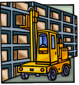



Goals, Components, Concerns
7: Multiple concerns: functionality, security, performance, technology…
2: Goal - Factories supplied just in time from supplier warehouses
Functionality
Security
Performance
Technology
…
3: Refinement to sub-goals + domain properties on sub-domains
1: Problem Domain – factories, supplies, warehouses, partners, existing systems
3b: predict production load, optimize supply schedule
3c: deliveries made
3a: track inventories
4: Scope of sub-goals get narrower.
Some assigned to components.
Factory Supply Optimizer
production load predictions
supply scheduling
supplier
inventory
deliveries
scheduling
predictions
5: Applications, Components, Connectors
– specifications for each one
– end-to-end satisfaction of goals
6: Goals and Domain Model have parallel refinement, to granular goals and components

Slide 10
MAp Viewpoints
Information supports goals, process
Process supports goals
Domain / Biz
Architecture
1
Outside
Domain: Information
Goals
Biz. Process
Goals – success criteria
Black box assembly includes S,
Supports business model
Traceability
Black box Assembly (including S)
Component Architecture
Black box Spec (of S)
S
1
S
1
S
2
E
D
S: Information
Boundary
4
S: Behavior
Architecture Styles: Principles, Patterns, Guidelines, Rules
3
Black box view of S
Architecture styles, patterns: across viewpoints, projects
White box view of S
sub-component s1…s3
Partitions behavior & information
1
2
S
S
Component Architecture
White box design (of S)
s2
Inside
s2
s1
3b
s1
s3
3a
s3
4
Information
Behavior
Each sub-component could be drilled-down if needed

Slide 11
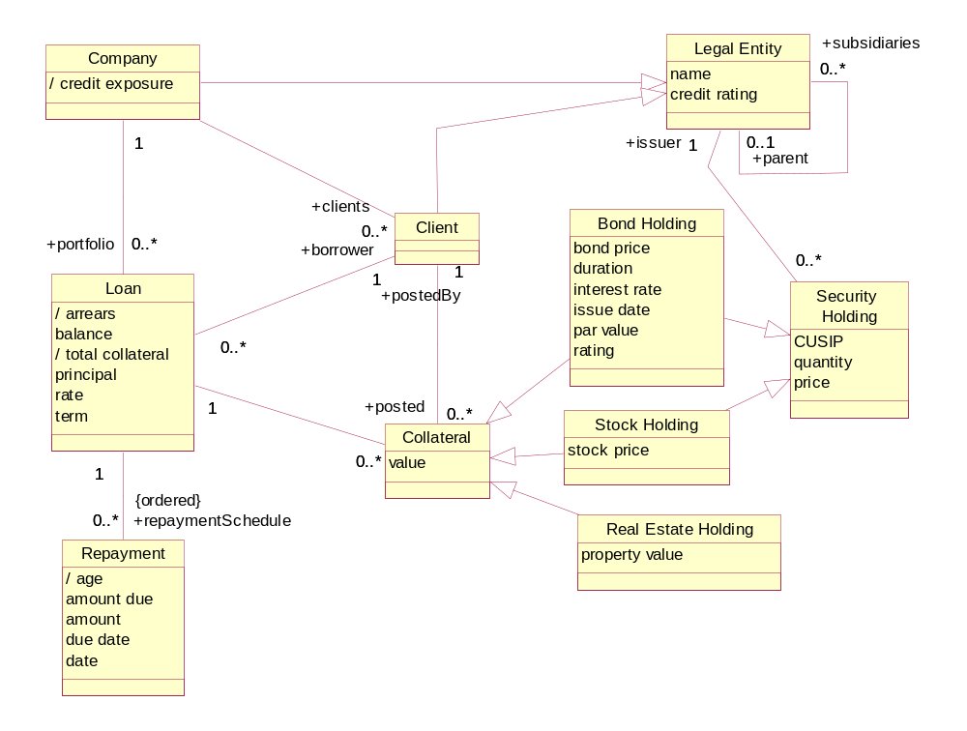
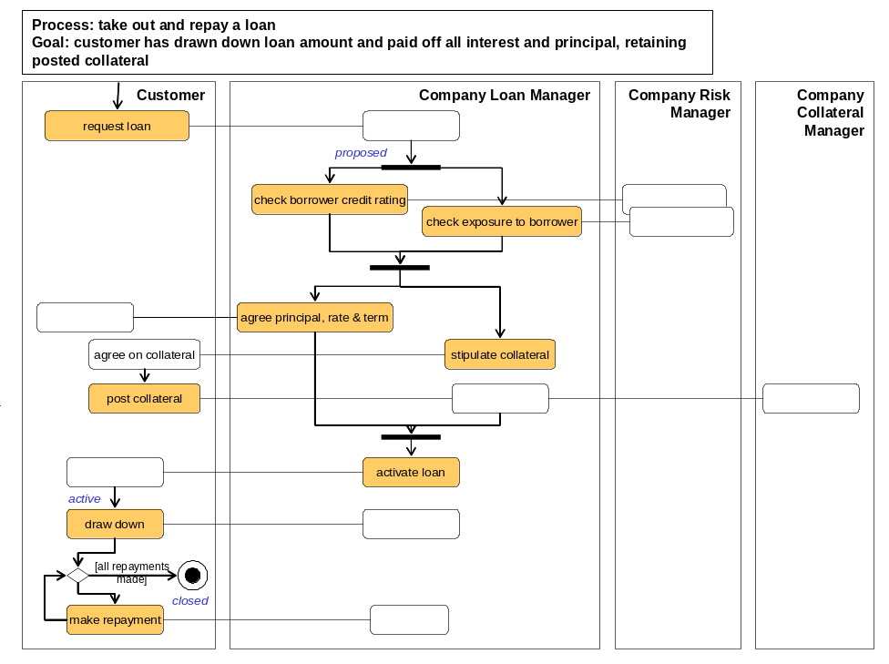
Loans Example – Goals, Domain Model, Biz Process Model
Goals clearly defined in Informational terms.
Goals refined into adequate sub-goals
Minimize Credit Exposure Risk
Maximize Return
Predict Risk
….
Adjust Risk Exposure Factors
…..
Unambiguous Information terms
Terms defined in “drill-down” as needed
Track Risk Prediction History
Improve Predictive Model Over Time
Business process demonstrably supports goals
Process activities clearly defined in Information terms

Slide 12
Example – Top Level Black Boxes Info Partition
Clear authoritative ownership of information by top-level components
Loans System
Reference Data System
Collateral Management
System
Explicit dependencies between information across components

Slide 13
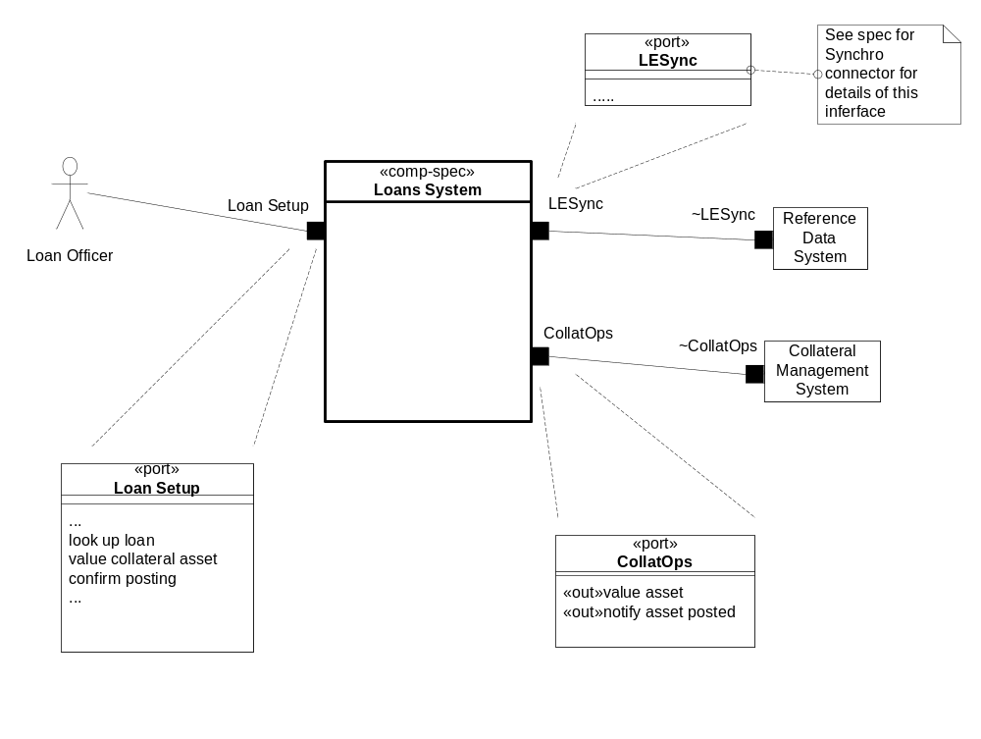
Example – Black Box Context
Services provided and required explicit
Logical connections between components clear
Information ownership and dependencies clear
Interfaces specified explicitly

Slide 14
Multiple Concerns, Styles, across Viewpoints
Functionality, security, location, technology … specified at suitable granularity and level
Module: build-time structure of software units including sources and tools
Location: deployment, location & connectivity: people, hardware, software
Technical: technical and platform realizations of components, ports, connectors
Concerns
Performance: throughput, response time, latency, data volumes, loads
Security: who can and cannot do what and to whom
Logical Functionality: what actions with what information and what triggers
1. Business Architecture
Business perspective on the problem or concern, including goals, activities, interactions, and information.
Outside
Architecture Styles: Principles, Patterns, Guidelines, Rules
Viewpoint
2. Component Architecture
– Black Box
Describe a large grained software component as a black box, with its behavior and information responsibility to others in its environment, for any aspect that is externally visible.
Boundary
3. Component architecture
- White Box
Design the “insides” of a black box component as a collection of connected sub-components, each a black-box, and decide how they collaborate to fulfill black box responsibilities.
Inside
Address all relevant concerns early in the process and in the appropriate viewpoint
Notes:
REVISIONS:
Add summary of UML diagrams used.

Slide 15
Outline
What is MAp?
Formal Architecture Framework
  Goal Modeling
  Viewpoints and Concerns – Black Box, White Box, Technical
  Architecture Style
Process Pragmatics
  Iterative and Incremental
  Roadmap Route: Problem Definition, Current State, Target State, Migration Plan
  Flexible Models and Domains
Summary

Slide 16
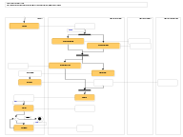
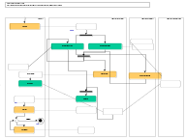
Architecture Principles and Styles
Architecture styles define rules of architecture conformance
Architecture styles define patterns of preferred or allowed architectures
One common form: Wherever you have … solve it by …
Very wide spectrum of styles in (and across) all viewpoints
  Business Process Style: Earliest point of data capture
    Wherever any process needs some information at multiple points …
    Capture the information at the first opportunity in process. Never require it again.
  Technical Architecture Style: MQ Series Configuration Style for Co-located Queues
    Wherever co-located components need a messaging connector …
    For a source S of events and a destination D that will be co-located on a single machine, use an MQ Series queue named <S><D><…>, configured as <….>, set up the S and D ends of the queue as <….>
  Technical Architecture Style: XML encoding styles
    Use nested entities for …; use attributes for …; compress names as follows …
  Integration styles: point-to-point, desktop, gateway, …
☑
☒
☑
☒

Slide 17
Outline
What is MAp?
Formal Architecture Framework
  Goal Modeling
  Viewpoints and Concerns – Black Box, White Box, Technical
  Architecture Style
Process Pragmatics
  Iterative and Incremental
  Roadmap Route: Problem Definition, Current State, Target State, Migration Plan
  Flexible Models and Domains
Summary

Slide 18
Two Aspects of the MAP Framework
Formal Architecture Framework
Goals
Viewpoints
Concerns
Models
Refinement
Architecture Styles
Process Pragmatics
Routes: Roadmap, Construction, …
Different Entry Points
Iterative and Incremental
List, Draft, or Dressed Templates
Guidelines
Checklists
Architecture always ties back to goals.
Different presentation suitable to audience
Clear and unambiguous architecture
How to prioritize and focus work?
How much detail is appropriate and when?
How to show early value and reduce risk?
How to customize to project needs?

Slide 19

MAp can provide complementary value to an SDLC
MAp
Roles
SDLC
1
PM Submits
Request
1
Outside
QA
Approval
Domain: Information
Goals
Biz. Process
Yes
Task
Complete
Black box Assembly (including S)
No
S
1
S
1
S
Lifecycle Process
PM Accept
Task to be
Completed/
Corrected
E
D
2
Boundary
Yes
2
S: Information
Architecture Styles: Principles, Patterns, Guidelines, Rules
Black-box Specification (of S)
S: Behavior
3
4
No
PSA
Override
Task
Complete
Yes
S
1
S
2
No
s2
s1
s2
Inside
Task Must be
Completed/
Corrected
s1
s3
3a
3b
s3
Information
Behavior
4
Document Templates
3
Adapt MAp to the SDLC structure for the organization
Add specific useful tools within the SDLC
  How to frame the problem and clarify the domain terminology
  How to derive and validate key architecture decisions
Fill in key parts of templates e.g. Business Requirements, Functional Specs
  Model of goals and it’s refinement to architecture decisions
  Specification of services, components, connectors
Define relations and consistency criteria across descriptions

Slide 20
Architecture Viewpoint ≠ Development Sequence
Each deliverable base-lined, frozen
Time
Waterfall
1. Business Architecture | Business perspective on the problem, including activities, interactions, and business information.
2. Component Architecture – Black Box - White Box | Describes one (or more) large grained software components as a black box, with its relation with others in its environment, including its behavior and information responsibility.
 | Designs the “insides” of each black box software component as a collection of sub-components, specifies each one, and decides how they collaborate to fulfill black box responsibilities.
4. Technical Architecture | Designs the connectors between the components to support their designed interactions, the platforms to support the components, mapping both to technology.
5. Deployment Architecture | Designs the hardware structure (nodes, connections, devices, …) and which deployable software units will map onto the hardware to support component execution and communication.
6. Module Architecture | Designs the deployable compiled software units, and how they are generated from structured source units, that are in turn determined from the application and technical architecture.
Iterative
1. Business Architecture | Business perspective on the problem, including activities, interactions, and business information.
2. Component Architecture – Black Box - White Box | Describes one (or more) large grained software components as a black box, with its relation with others in its environment, including its behavior and information responsibility.
 | Designs the “insides” of each black box software component as a collection of sub-components, specifies each one, and decides how they collaborate to fulfill black box responsibilities.
4. Technical Architecture | Designs the connectors between the components to support their designed interactions, the platforms to support the components, mapping both to technology.
5. Deployment Architecture | Designs the hardware structure (nodes, connections, devices, …) and which deployable software units will map onto the hardware to support component execution and communication.
6. Module Architecture | Designs the deployable compiled software units, and how they are generated from structured source units, that are in turn determined from the application and technical architecture.
Time
Same deliverable refined across iterations
Development often should not be waterfall i.e. not 1-viewpoint at a time
Each iteration can cover multiple viewpoints
Same deliverables is refined across iterations
Same models can be presented as tables, bullet lists, formal diagrams
Flexible form with consistent content

Slide 21
Outline
What is MAp?
Formal Architecture Framework
  Goal Modeling
  Viewpoints and Concerns – Black Box, White Box, Technical
  Architecture Style
Process Pragmatics
  Iterative and Incremental
  Roadmap Route: Problem Definition, Current State, Target State, Migration Plan
  Flexible Models and Domains
Summary

Slide 22
Roadmap
Route
Initial issues, objectives, pain points, etc.
buried business knowledge
refine goals and obstacles
for target state work
Frame the Problem: formalize problem, syndicate with stakeholders
Goals model Key domain terms
known reference architectures,
best practices, etc.
top-level problem definition,
domain terms to map,
priorities, focus areas
Analyze The Current State
Define The Target State
Business architecture
scenarios and process sketches
key information terms
problems and opportunities
Business architecture
principles and styles
processes, roles, activities
validation vs. goals and obstacles
problems and opportunities
Component architecture:
principles and styles
black-box
  top-level assembly
  context: ports, use cases
white-box
  sub-component assembly
  end-to-end collaborations
technical properties, mapping styles
validation vs. goals and obstacles
target reference architecture
e.g. components, functions,
information … for inventory
Component architecture
application inventory and map
non-functional and technical props
problems and opportunities
Plan The Migration
relationship to other roadmaps and projects
goals, constraints, architectural sequencing dependencies
migration principles, stages: evolving architecture snapshot with gaps, cost
cross-project
“program” conformance
project funding
project requirements
project funding
project requirements
project funding
project requirements

Slide 23
Summary and Discussion
Model-driven approach to domain and business-aligned architecture
Address both business and technical concerns
Clear separation of viewpoints for simpler architectural descriptions
Different entry points and routes applicable to different projects
Can be used to differing degrees of completeness and rigor as needed

